Slide 1
TimeLine of Router
Attacks and Defenses

Slide 2
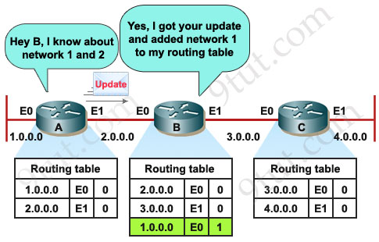
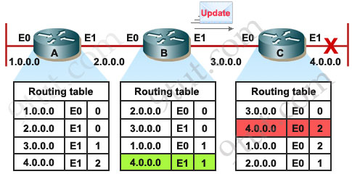
A Scalable Method for Router Detection and Location in Link State Routing
2003
Routing table poisoning can lead to many problems such as dos, packet congestion, Over whelmed host, Looping , Access to data.
Fig 1 . https://www.9tut.com/rip-routing-protocol-tutorial

Slide 3
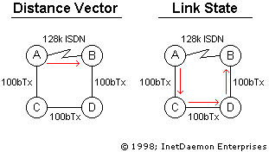
Secure Link State protocol
The two most important components of defense is
A. consistency:- This check works on the receiving router.
B. Synchronization: It is based on the principle of voting
Fig 2

Slide 4
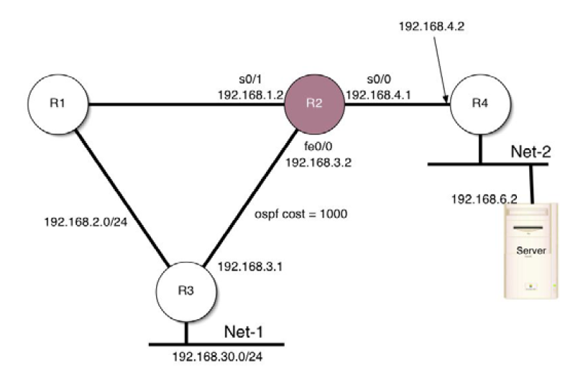
Attacking Routers by Packet Misrouting [7]
2004
The authors assume that a router has already been compromised, and the configuration file of the router can be modified freely.
How?
1. Static routes
2. Access Control Lists

Slide 5
Static routes & Access Control LISTS
Fig 3: Attacking Routers by Packet Misrouting
Notes:
Suppose we have a server on Net-2
with IP address 192.168.6.2. Note that R2 is the
compromised router. Under normal condition R2
will forward packets destined to 192.168.6.2 to R4.
But if we set up a static route (in R2) which
forwards all these packets to R3, a routing loop for
the address 192.168.6.2 is created. Figure 2 shows
the configuration of R2 with the static route setting
being highlighted. Note that this static route is not
redistributed to the OSPF routing process in R2.
This means that other routers will not know about
this static route in R2

Slide 6
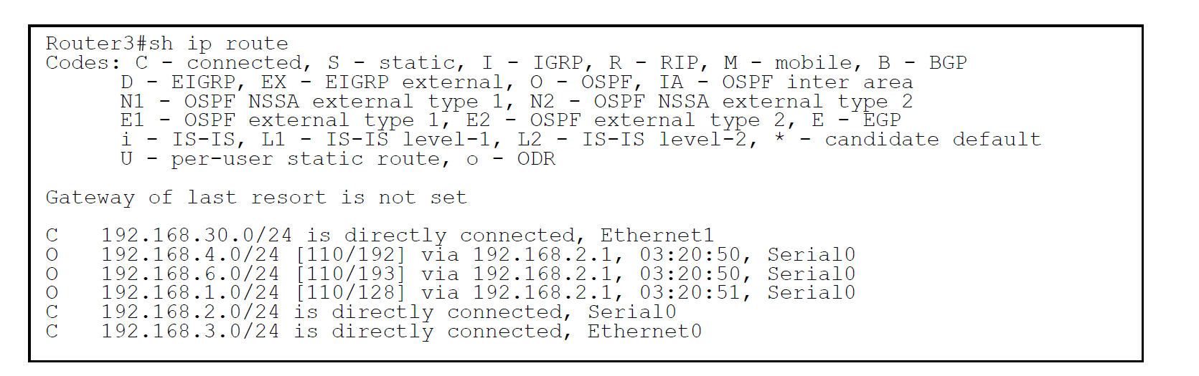
Static routes & Access Control LISTS

Slide 7
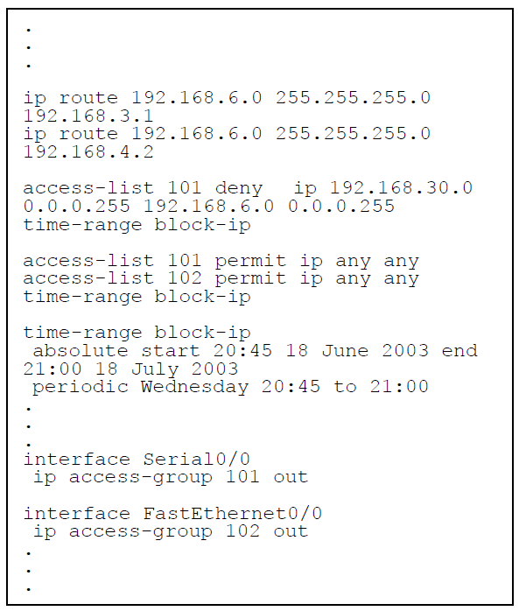
Time based Access Control LISTS
The first one points to the wrong direction (192.168.3.1) and the second one to the correct one (192.168.4.2).
By using two access control lists (101 and 102), we can control the packet flows, sourced from 192.168.30.0 and destined to 192.168.6.0, under different time intervals.

Slide 8
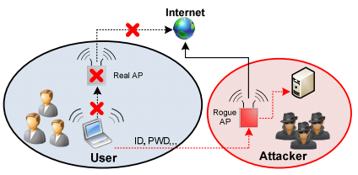
Security Enhanced IEEE 802.1x Authentication Method for WLAN Mobile Router [2]
2012
Problem: Security threat in WLAN environments is MITM (Man-in-the-middle) attacks using rogue APs. (It used static shared secrets, it leads high risks of the leak of shared secrets)
2012
Fig. 1 Man in the middle attack using rogue access point [2].
Proposed method: WLAN security standard applies the authentication method by using TPMs (Trusted Platform Module).

Slide 9
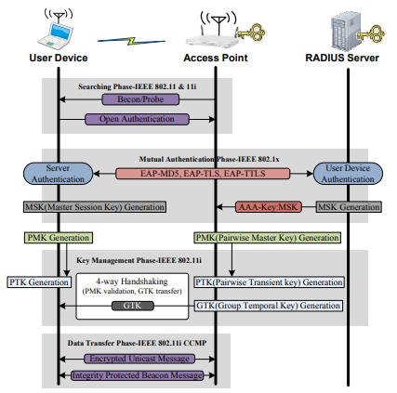
Security problems [2]
• Mobile routers can be exposed to the risks of robbery and device hacking.
• Attacker can find out shared keys and easily configure rogue APs with the mobile router.
Fig. 2 WLAN security procedure based on IEEE 802.11 & IEEE 802.1x [2]

Slide 10
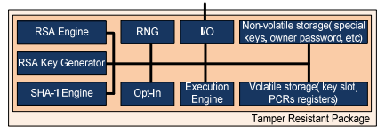
Trusted Platform Module [2]
It is a secure crypto processor composed of an independent chipset (It has Random Number Generator, Hash engine, RSA engine , RSA key generator, key storage)
It can authenticate hardware devices (Chip has a unique and secret RSA key)
Fig. 3 Architecture of Trusted Platform Module [2].

Slide 11
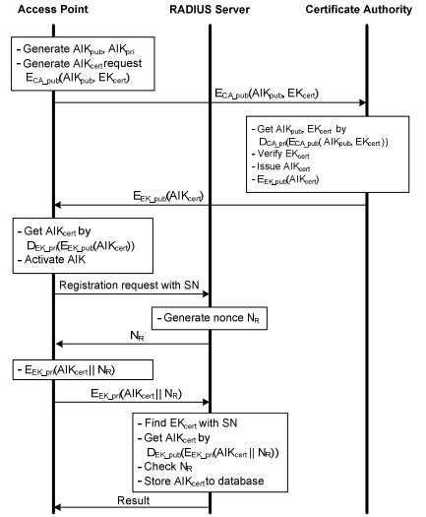
proposed authentication method [2]
• This method applies a new device authentication method using TPM
• The EK_pri used by the AP in the
encryption exists only in the TPM and
cannot be modified.
• Only those APs known by the server can
register their AIKcert (Attestation Identity
Keys)
Fig 4. Access Point initialization & registration procedure [2]

Slide 12
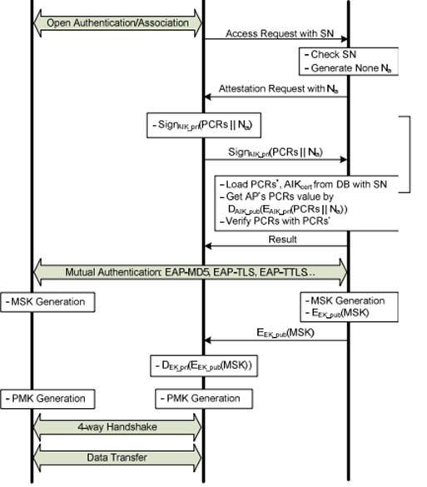
authentication PROSEDURE [2]
• The server verifies the attestation value presented by the AP requesting for access.
• The EK_pub (Endorsement key) of the TPM encrypts with a key in the process of delivering the MSK
• The encrypted MSK can be decrypted by only those APs registered with the server.
• The integrity of the APs requesting access is verified
• MITM attacks using rogue APs can be fundamentally blocked
Fig. 5 Security enhanced IEEE 802.1x authentication procedure [2]

Slide 13
Router Attacks Detection Through Log Analysis and Defense Mechanism
2013
A router can be attacked in many ways by a hacker (mostly):
1. DDoS Attack (ARP poisoning, Smurf attack, Ping of Death)
2. Man in the Middle (MiM) attacks (ICMP redirect attack)
Analysis of router’s logs can give a lot of insight in attacks detection
ACL on the router is as defense mechanism
PROPOSED SYSTEM
Router Configuration (to direct logs to another host (Syslog server).
Syslog Server (Routers have very less memory. Also, log analysis can be done effectively on this machine).

Slide 14
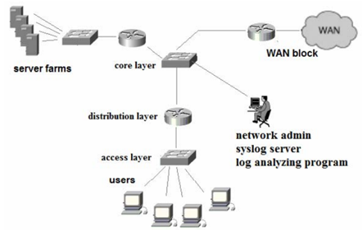
DEPLOYMENT OF Syslog Server [3]
The Syslog server is connected to the core switch
All the routers can direct their logs to the Syslog server (Network admin can monitor all the routers)
Fig 2. Deployment of Syslog Server in Campus Network [3]

Slide 15
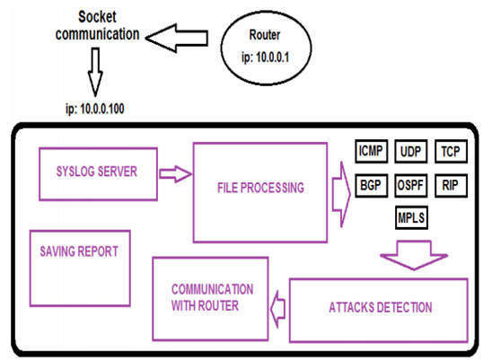
Components of the log analyzing system [3]
Syslog file are separated
and written into separate files according to protocol.
The algorithms for detection of router attacks
Communication with router module will be required to configure ACLs on the router to defend the attack
Fig 2. Components of log analyzing system [3]

Slide 16
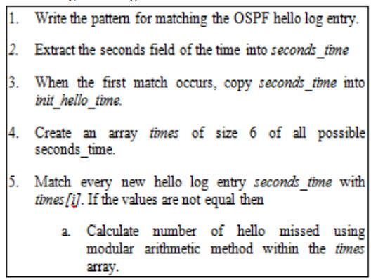
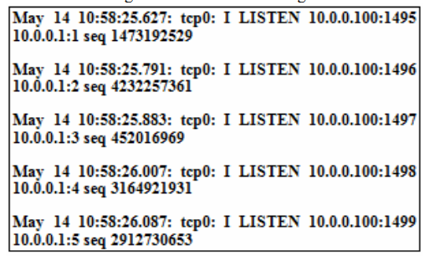
Attacks Detection [3].
Algorithm for detecting OSPF hello packets deletion attack. Log entries during port scan attack
Fig. 5 Algorithm for detecting Open Shortest Path First protocol (OSPF) hello packets deletion attack [3]
Analysis of router’s logs can give a lot of insight in attacks detection

Slide 17

Router Attacks-Detection And Defense Mechanisms [9]
Denial-Service attacks on routers:
Address Resolution Protocol poisoning
The attacker forms a packet containing more than 65536 bytes. IP protocol cannot handle packets with size more than 65536
The attacker sends out a lot of ICMP echo request packets to different hosts. The source address of all these echo request packets is kept as the address of the victim by the attacker
2013

Slide 18
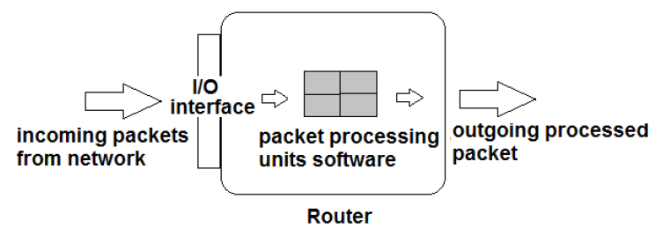
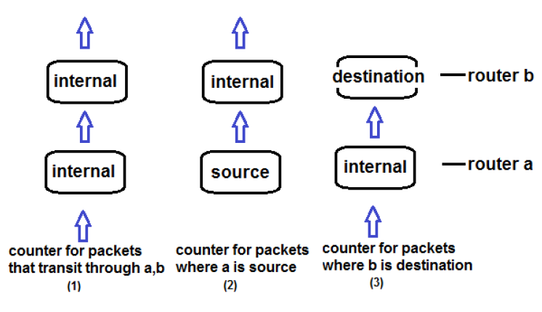
How to Defend?
The number of packets (consider size) that are outgoing from a should be equal to the number of packets that are incoming to b. This is the rule when both a, b are internal routers. Same rule can be transformed when some source or destination is involved.
Fig 2: Router with processing units
Fig 4: Counters maintained by router
Notes:
1. A counter for packets that flow ―through‖ both a, b
2. A counter for packets whose source is a but which flows through b
3. A counter for packets that flow ―through‖ a but whose destination is b
Similarly router a will also maintain three more counters for the opposite direction.

Slide 19
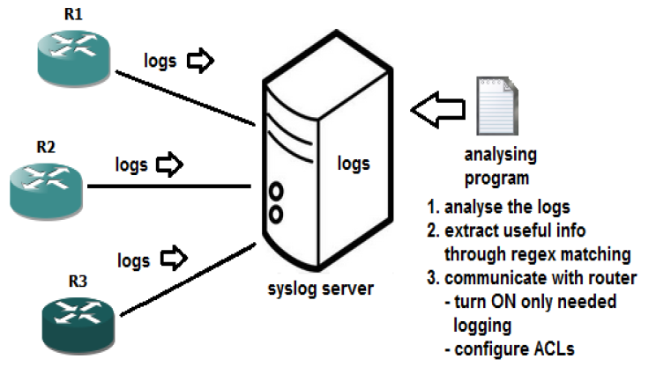
LOG MONITORING TO PREVENT Attacks
Direct the router logs to a separate syslog server
To maintain huge logs using the logging trap command limits the logging messages sent to syslog servers to logging messages with a level up to and including the specified level argument.
Create a logging analysis program
Fig. 7 Deployment of analyzing program

Slide 20
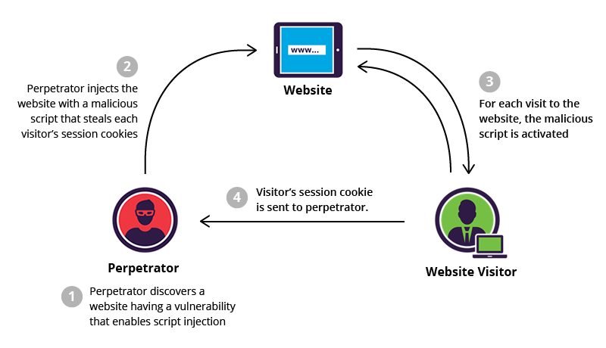
Research paper- Owing Home Router
2015
Attacks Presented Are:-
Cross site scripting (XSS) injects malicious code into a web application.
The two types of XSS attacks are reflected and stored.
In the Reflected XSS the malicious code is embedded in the GET or POST request of the website.
In the Stored XSS the malicious code is embedded in the web page itself.
Fig 15. https://www.incapsula.com/web-application-security/cross-site-scripting-xss-attacks.html

Slide 21
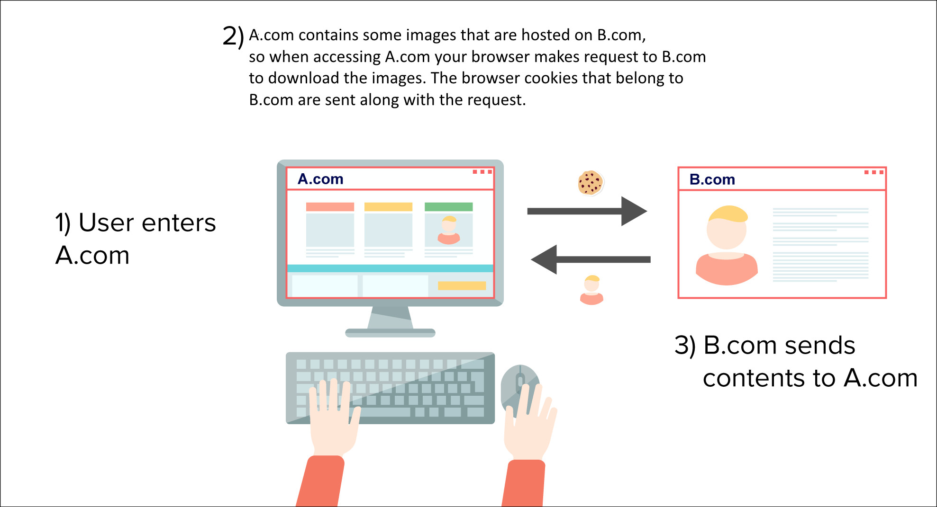
Cross-site request forgery
In this attack the attacker can send unauthorized HTTP request.
The CSRF does not work on websites which are protected by basic authentication.
Fig 16. https://www.netsparker.com/blog/web-security/same-site-cookie-attribute-prevent-cross-site-request-forgery/

Slide 22
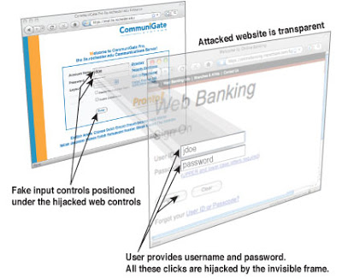
UI Redressing
In the attacker can modify the behavior and the look of an web page.
These days the browser have a policy called as same origin policy (SOP) which prevents this kind of attack.
The authors have shown ways in which we can by pass the SOP. This technique uses drag and drop method.
Fig 17 http://smartechverse.blogspot.com/2015/07/clickjaking.html
Notes:
Explain with example of kitten drag and drop feature

Slide 23

Defenses Presented are:-
Randomization of Default login data.
Minimize Information Leakage
SSL/TLS- this prevents against sniffing attacks and man in the middle attack
Input validation to prevent cross-site scripting
X-Frame Options:- This prevents the use of classic clickjacking attacks

Slide 24
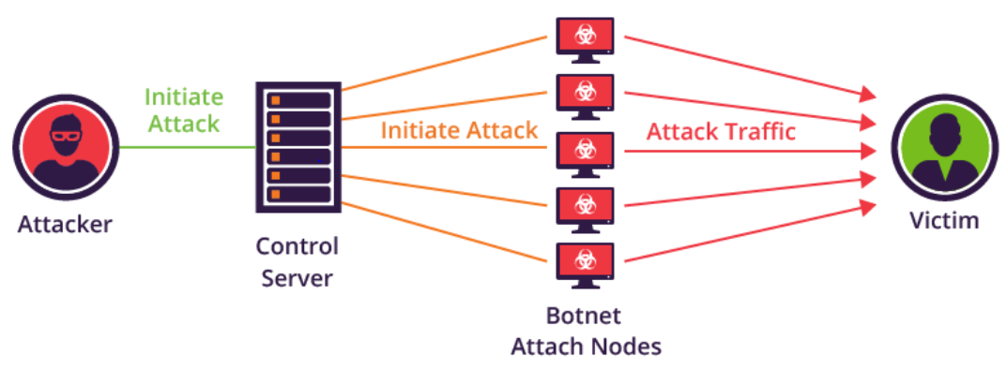
Home Routers: Understanding Attacks and Defense Strategies [8]
2016
Mirai Attack affected at least 5 billion routers
It’s a malware that turned networked devices running Linux into remotely controlled "bots”.
It primary targets:
IP cameras
Home routers
Fig 1: https://www.incapsula.com/blog/how-to-identify-a-mirai-style-ddos-attack.html

Slide 25
Built-In Backdoors
A backdoor was found in the WAN part of the Netis/Netcore routers3 that allowed attackers to access, and consequently, compromise routers through the execution of arbitrary commands and by making the routers susceptible to man-in-the-middle (MitM) attacks.
A backdoor is a malware type which can surpass the normal authentication process for accessing any system or application.
Some backdoors are legitimate and assist, for instance, manufacturers to regain lost passwords. However, these backdoors can be used by attackers to remotely access the systems without anyone on the system knowing it.

Slide 26
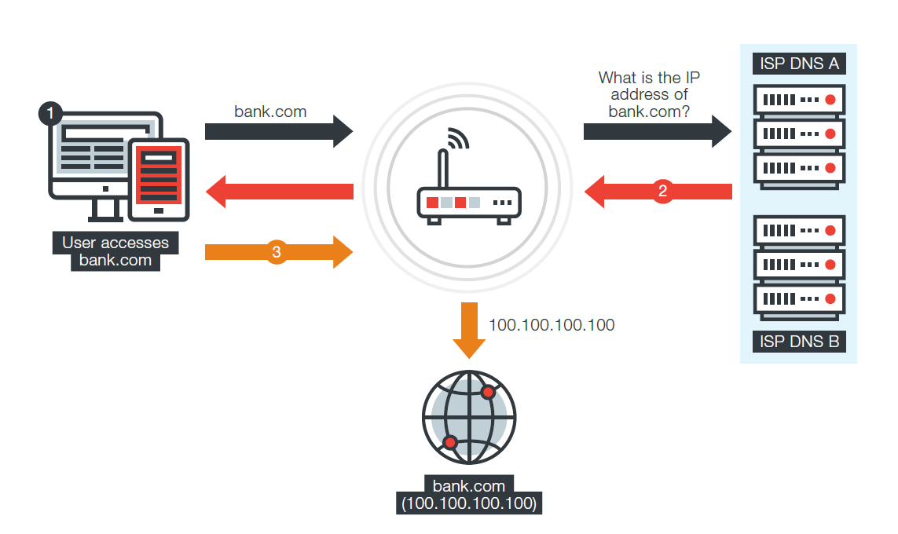
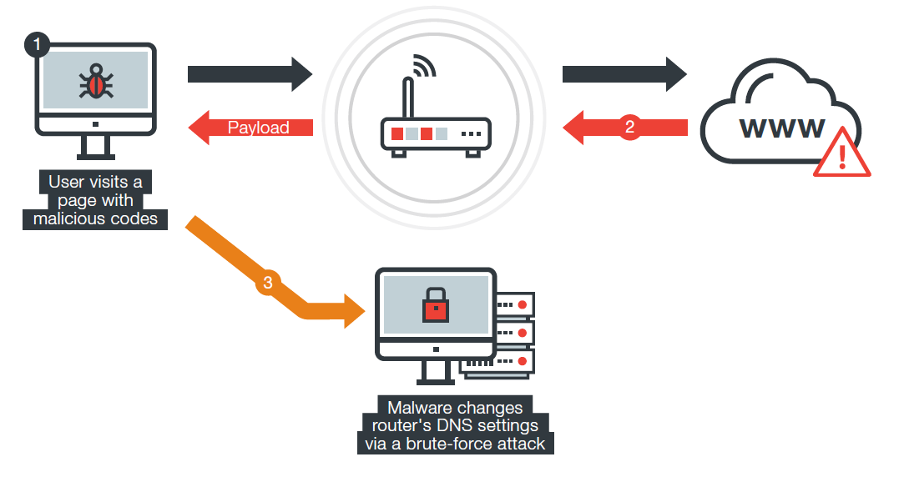
DNS Changers
The home router also keeps the DNS cache and queries the internet service provider (ISP)’s DNS servers to resolve new names.
Once the DNS settings are changed, all connected devices are affected since users could be redirected to malicious or phishing websites.
Figure 10: The difference in how the DNS settings work before and after a router is infected with malware

Slide 27
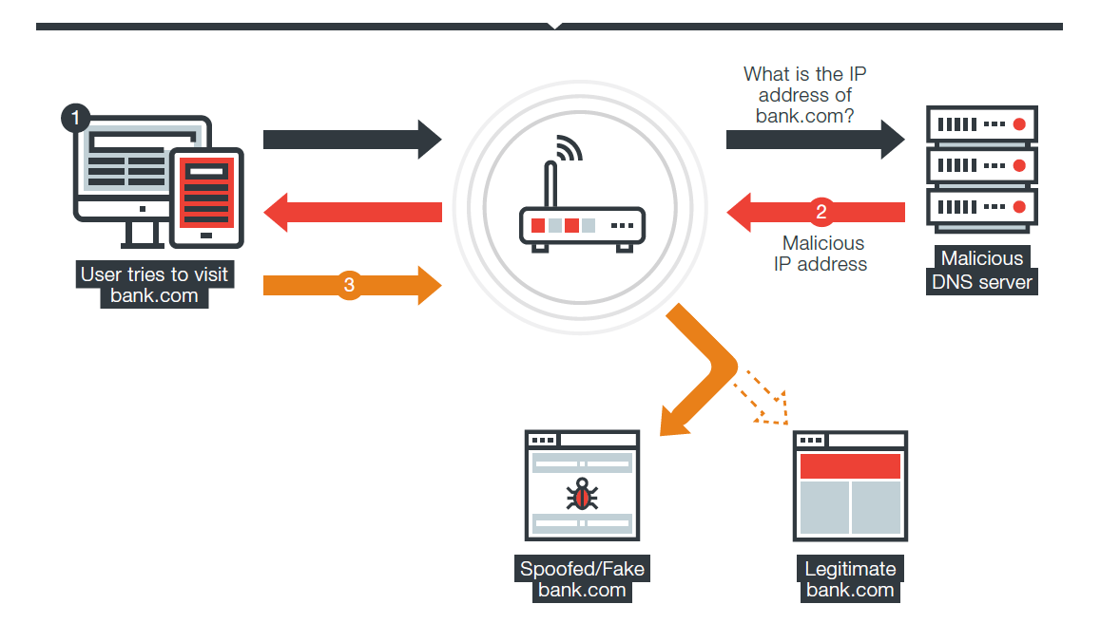
DNS CHANGERS
One notable DNS-changing malware family is HTML_DNSCHA.
This malware family originated from Brazil, which was one of the countries that were badly affected by the aforementioned malware.
Figure 10: The difference in how the DNS settings work before and after a router is infected with malware

Slide 28
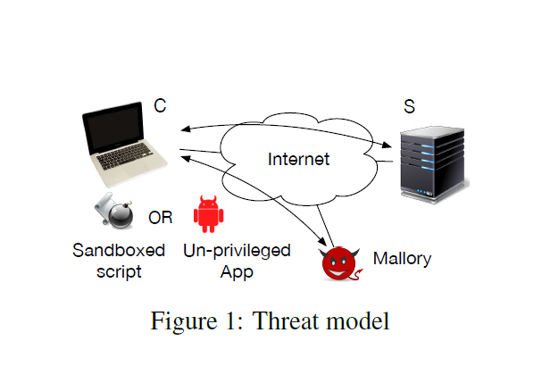
Off-Path TCP Exploit: How Wireless Routers Can Jeopardize Your Secrets [10]
2017
Half-duplex nature of Wi-Fi creates a “shared resource” among uplink and downlink traffic
Wi-Fi relies on carrier-sense multiple access (i.e., CSMA), i.e., transmits only when the channel is sensed idle.
This effectively creates a timing channel that delays the local transmission if the opposite direction is transmitting at the same time.

Slide 29
Concept behind exploiting the timing channel
The attacker sends a spoofed probing packet, along with a pre-probe query and post probe query to measure the RTT before and after.
If the spoofed packet does not trigger an ACK on the client, because the guessed sequence number is in-window, then the post-probe query arrives at the client faster and gets back sooner.
On the other hand, if the spoofed packet triggers an ACK on the client, e.g., because the guessed sequence number is out-of-window, then the post probe query experiences contention with the ACK from the client, and therefore prolongs the measured RTT.

Slide 30
Integration of Software Router with Wi-Fi for Enhanced Security [1]
2017
Separate hardware devices for router and firewall lack security and have drawbacks:
User credentials can be hacked as these details are not encrypted with security standards in Wi-Fi (it can lead to loss of confidential information)
User credentials can be noted and encryption techniques can be identified by regular notice of data.
Configuration on the firewall cannot be changed as it is a closed system
The existing software routers cannot block the HTTPS traffic (however, it is necessary to secure the organization’s confidential data and to avoid unauthorized access)
Proposed solution is Vyatta software router:
It includes both router and firewall configurations to overcome the drawbacks of the hardware device.
Enabling the Wi-Fi module on Vyatta router can block HTTPS websites

Slide 31
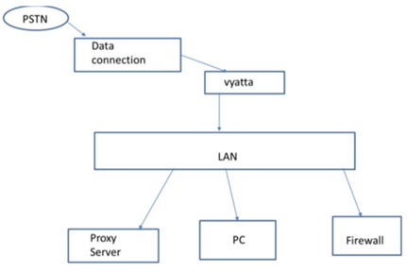
Integrated Wi-Fi module with Vyatta software router [1]
An integrated Wi-Fi module with Vyatta software router is developed on a virtual machine.
Telephone network (PSTN) provides data connection to the routers
Fig. 1 Integrated Wi-Fi module with Vyatta software router [1]

Slide 32
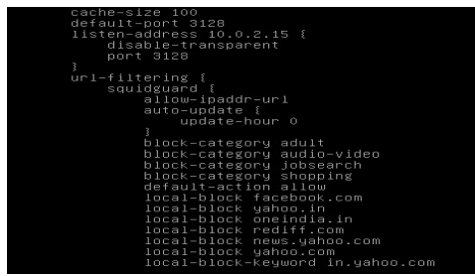
RESULTS [1]
Code to Block Websites
Fig. 5 Code to Block Websites [1]

Slide 33
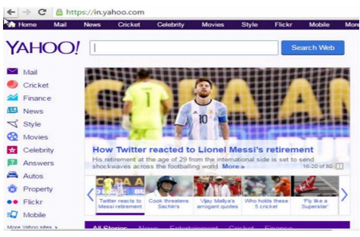
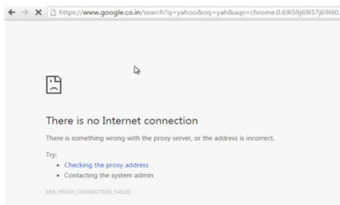
RESULTS [1]
Before Blocking
after Blocking
Fig. 5,6 Before Blocking. After Blocking [1]
Vyatta software router allows users to change the required firewall policies and block the secured and non-secured websites.

Slide 34
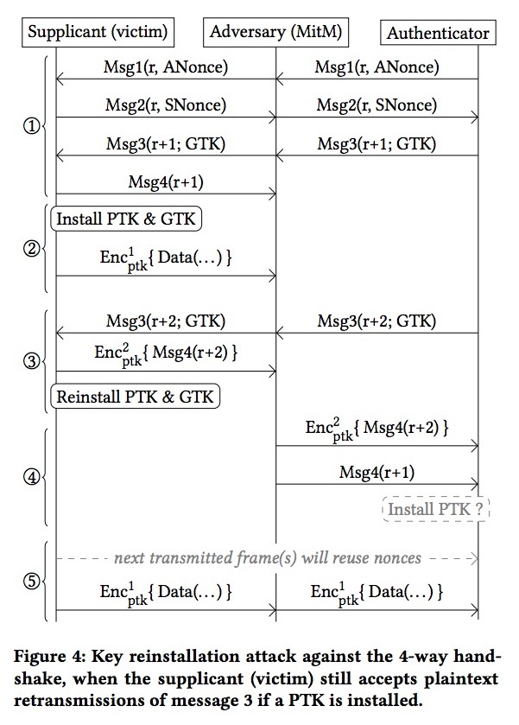
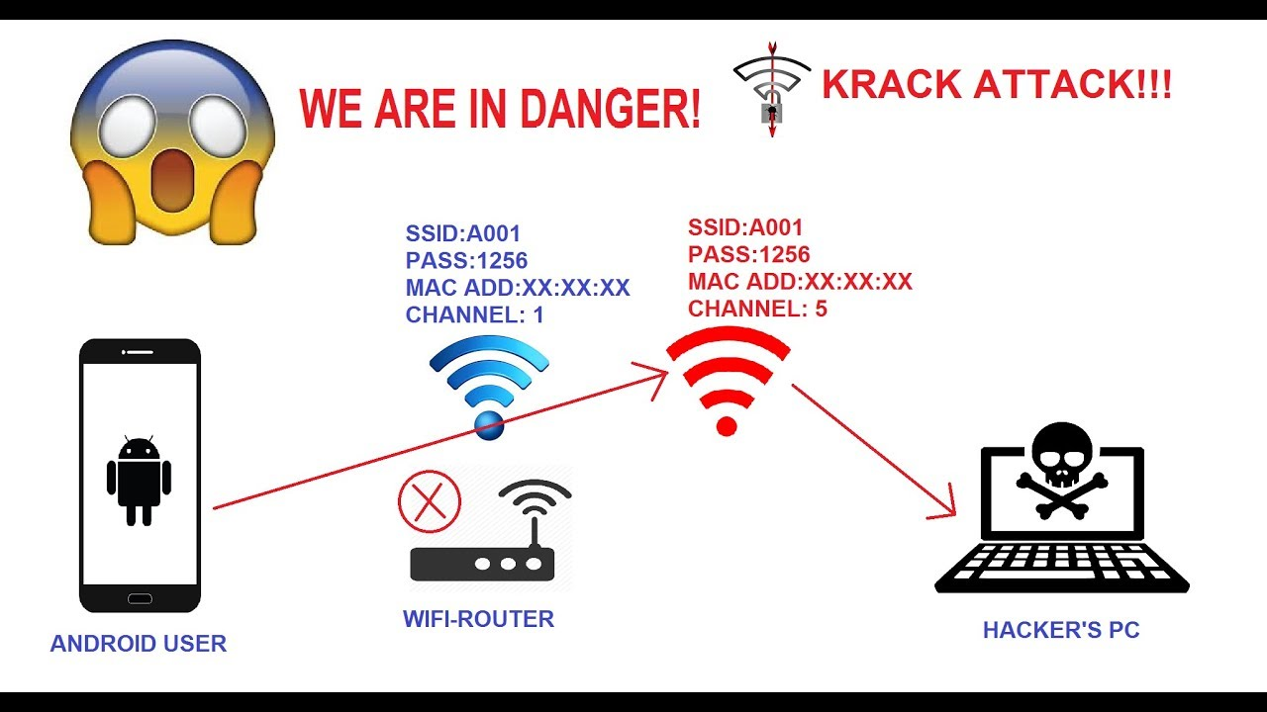
Key Re-installation attack
2018
This attack has limitation that it shall only work if the attacker is within the range.
Solution:-
Currently the only solution to combat the KRACK attack is to change the Wi-Fi protocol and replace it with WPA3( which is still in progress)
Fig. AD Tech tips
Fig https://www.allaboutcircuits.com/news/krack-attack-in-wpa-2-devices-threatens-the-4-way-handshake-protocol/

Slide 35
Future Research
Even though IEEE 802.11ax working group has been considering the possibility of supporting in-band full-duplex communication, research still needs to be done to make sure the real-world challenges such as backward compatibility is carefully considered and addressed.
Manufacturers have begun introducing changes with features like embedded security, password policies, CAPTCHAs, and users’ access control lists (ACLs), among others. These features, however, also mean additional costs for home users and thus become a big challenge for ISPs. As such, we believe that home routers will still be a prime target of cybercriminals.
Why not all websites are encrypted, so that, the attacker cannot inject a malicious payload into the connection. All websites must run under the secure connection of HTTPS.
The WPA3 seams to be the new cutting edge technology ,It promises to make the public network more secure and shall protect against brute force password attacks. This protocol is still in making but has al ready garnered a lot of attention from the techno world.

Slide 36

REFERENCES
[1] Chaitra S. and Sharma R. Integration of Software Router with Wi-Fi for Enhanced Security. IEEE 7th International Advance Computing Conference, pp. 33-36, 2017.
[2] Park K., Yong Soo Kim Y., Kim J., Security Enhanced IEEE 802.1x Authentication Method for WLAN Mobile Router, 2012 14th International Conference on Advanced Communication Technology (ICACT), pp. 550-553, 2012.
[3] Waichal S., Sonune G., and Meshram B.B. Router attacks detection through log analysis and defense mechanism. IRACST – International Journal of Computer Networks and Wireless Communications, Vol.3, pp. 251-256, 2013
[4] Owning Your Home Network: Router Security Revisited.
[5] A Scalable Method for Router Attack Detection[2395]
[6] Release the Kraken New KRACKs in the 80211 Standard[2399]

Slide 37
REFERENCES
[7] K. H. YEUNG and W. K. FUNG Attacking Routers by Packet Misrouting, 2004 Tele traffics and Networking Laboratory, City University of Hong Kong
[8] Joey Costoya, Ryan Flores, Lion Gu, 2016, Home Routers - Understanding Attacks and Defense Strategies, Trend Micro Forward-Looking Threat Research (FTR) Team, Trend Labs research paper.
[9] Saili Waichal, B.B.Meshram, Router Attacks-Detection And Defense Mechanisms, international journal of scientific & technology research volume 2, issue 6, June 2013
[10] Weiteng Chen and Zhiyun Qian, University of California, Riverside, 2016, Off-Path TCP Exploit: How Wireless Routers Can Jeopardize Your Secrets, 27th USENIX Security Symposium.

Slide 38
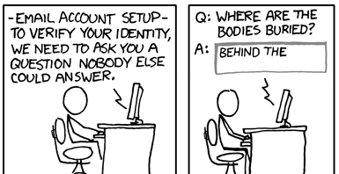

Thankyou ☺

